Slide 1
Lab equipment management system for
DECODE GENOMICS & RESEARCH CENTER

Slide 2
Background of study
The system is to make online web application for the customer to make the purchase payment easy.
This project is aimed to develop an online application for admin to keep the records of customer and products.

Slide 3
Introduction of the organization
DGRC is a Molecular Diagnostic Laboratory dedicated in providing molecular diagnostic services and lab equipment services to its customers. It was established on 2015.

Slide 4
Current situation of the organization
In the current situation, DGRC works in traditional method for selling the product .
The record keeping system is still not digitalized yet.

Slide 5
Objective of the study
The system aims to help the customer to purchase the product online through the internet .
To build a web based application that manages DGRC
To sell the lab equipment’s online
To keep the sales record
To manage the customer

Slide 6
Methodology: Data and information
Primary sources
Secondary sources

Slide 7
Functional requirements
Admin can add, delete update product and its category
Customer and Admin can login in the system
Customer can order the Equipment

Slide 8
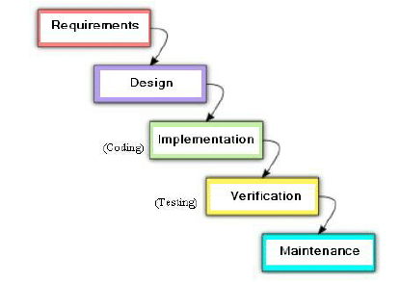
Project framework:
Waterfall Model

Slide 9
Reason to select waterfall model:
Prior to design, each phase and necessity is specified.
Simpler to comprehend and apply.
No requirements for development or execution that are unclear.
It is predictable and has distinct milestones.

Slide 10
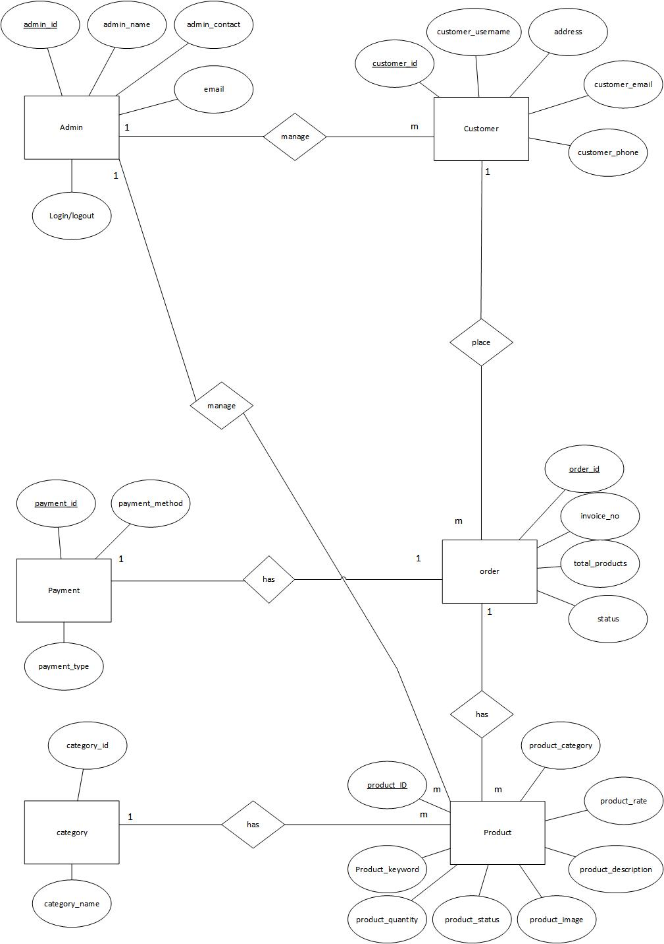
ER-Diagram

Slide 11
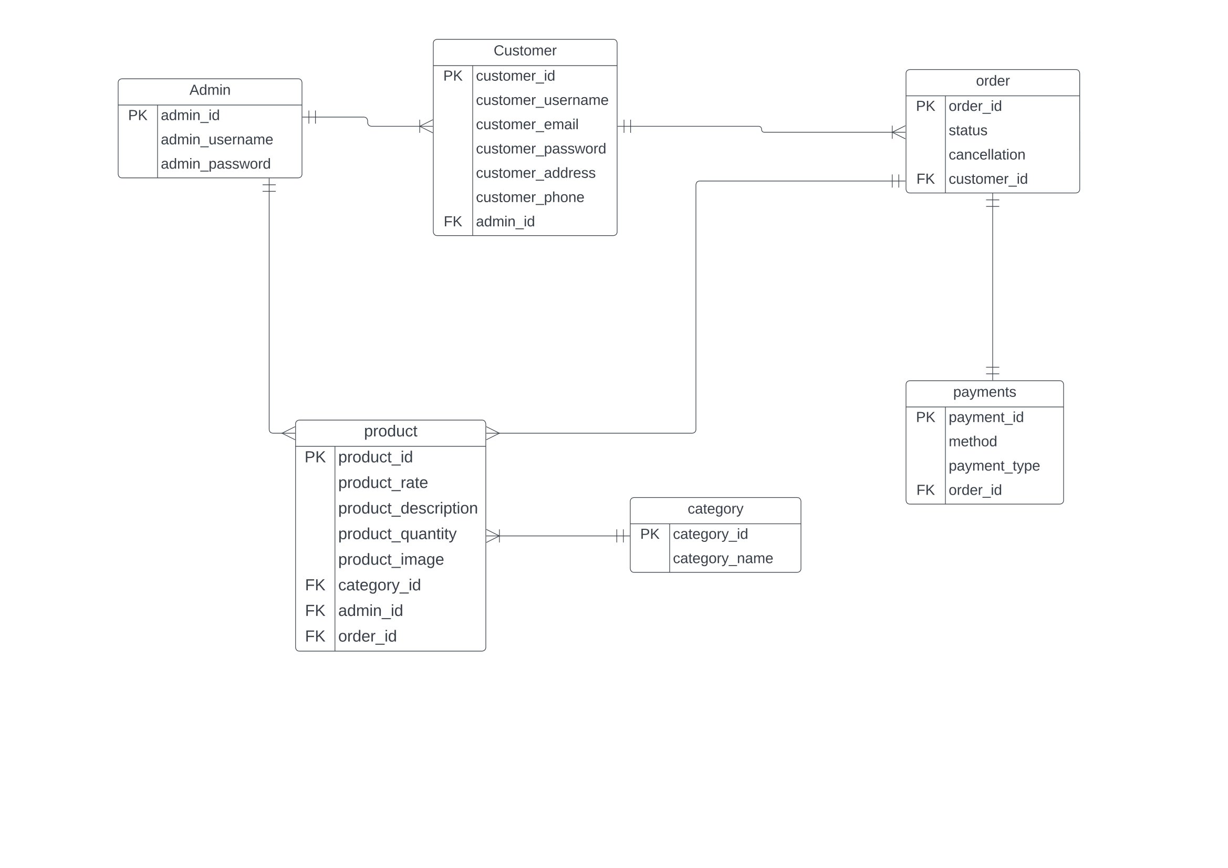
Relational model

Slide 12
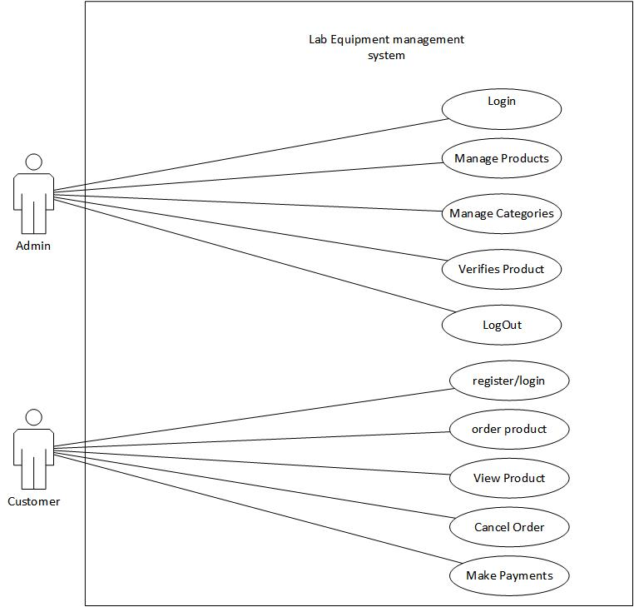
Use case diagram

Slide 13
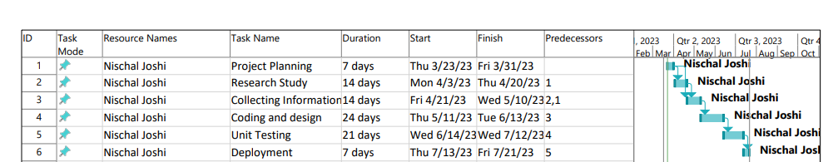
Gantt chart
Lab Equipment Management System

Slide 14
Tools used
Microsoft project
Microsoft Visio
Microsoft word for project documentation
Visual studio code

Slide 15
outcomes
User friendly interface
Customer can order the product
Admin can manage the product and it’s different category
Admin can manage the customer

